Slide 1


Mercedes-Benz G600 Maybach
Marketing Strategy Overview

Slide 2
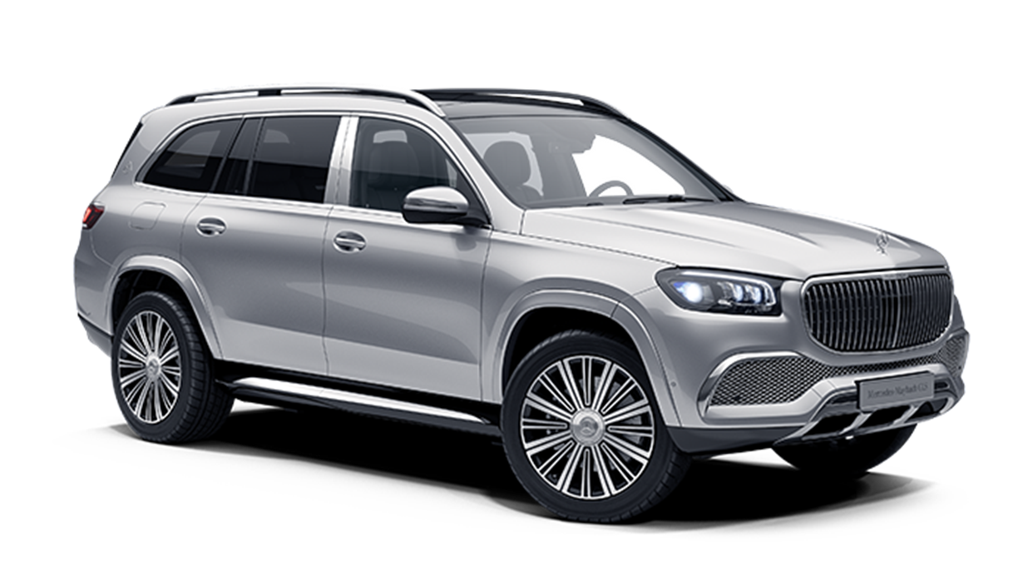
Mission Statement
The Mercedes-Benz G600 Maybach redefines luxury and performance, combining the rugged G-Class capabilities with Maybach's unparalleled luxury and sophistication.

Slide 3
Marketing Objectives
Increase Brand Awareness: Achieve a 25% increase in brand recognition within the high-end SUV market over the next year.
Sales Target: Sell 99 Units in a year.
Customer Satisfaction: Keep our customers 95% satisfied or more.
Market Penetration: Get 10% of the high-end SUV market in a year.
Digital Engagement: Boost online activity (website visits and social media) by 30% in six months.

Slide 4
Marketing Mix (Product)
Product: combines the off-road capabilities of the G-Class with Maybach’s luxury features
Price: The brand caters to a niche segment who value quality more than the price.
Place: available worldwide.
Promotion: all media channels for promotion. focusing on exceptional customer experience

Slide 5
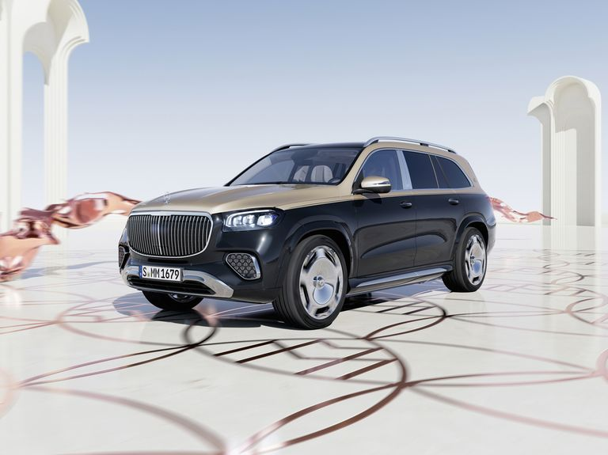

Positioning
The Mercedes-Benz G600 Maybach is a high-end vehicle known for its comfort, powerful performance, unique features, and exclusivity. It's designed to cater to the luxury market.

Slide 6

Target market
Demographics: high-Class individuals aged 35-65.
Geography: focus on markets in North America, Europe, the Middle East, and Asia.
Psychographics: People valuing exclusivity, luxury, high performance, and investing in unique, limited items.

Slide 7
Marketing Funnel
Awareness: Customers learn about the Mercedes-Benz G600 Maybach through various channels.
Interest: They research more about the car, visiting the Mercedes-Benz website or reading reviews.
Desire: They compare the G600 Maybach with other luxury cars and see how it fits their lifestyle.
Action: They decide to purchase the car.

Slide 8
Customer Journey Maps:
1. Online Purchase Journey:
Research
Comparison
Purchase: completes the transaction on the Mercedes-Benz website.
2. In-Person Purchase Journey:
Awareness
Test Drive
Negotiation
Purchase: completes the transaction at the dealership.

Slide 9
Metrics & KPIs
1. Brand Awareness: Use surveys and social metrics.
2. Sales: Number of units sold.
3. Customer Satisfaction: Utilize surveys and feedback.
4. Market Share: Analyze industry sales data.
5. Digital Engagement: Check web traffic, social metrics, and ad performance.

Slide 10
Marketing Tactics
Website: Create a site with high-quality visuals and 360-degree views.
Social Media: Work with influencers and luxury bloggers.
Email Marketing: Send event emails to prospects and customers.
Events: Host launch events with luxury partners.

Slide 11
Marketing Tactics
Public Relations: Work with top auto and luxury publications.
Advertising: Place ads in luxury magazines, websites, and social media.
Sales Promotions: Offer limited-time deals.
Customer Service: Provide top-notch service.

Slide 12
Any Questions ?

Slide 13
Thank You
Members:
Taqieldeen Mohammad 2022/03065
Seif Ahmed Hussien 2023/08433
Mohamed Amr Sabry 2023/00717
Yousif ahmed mohamed 2022/07806

